Slide 1

Mongo DB – Part 1

Slide 2
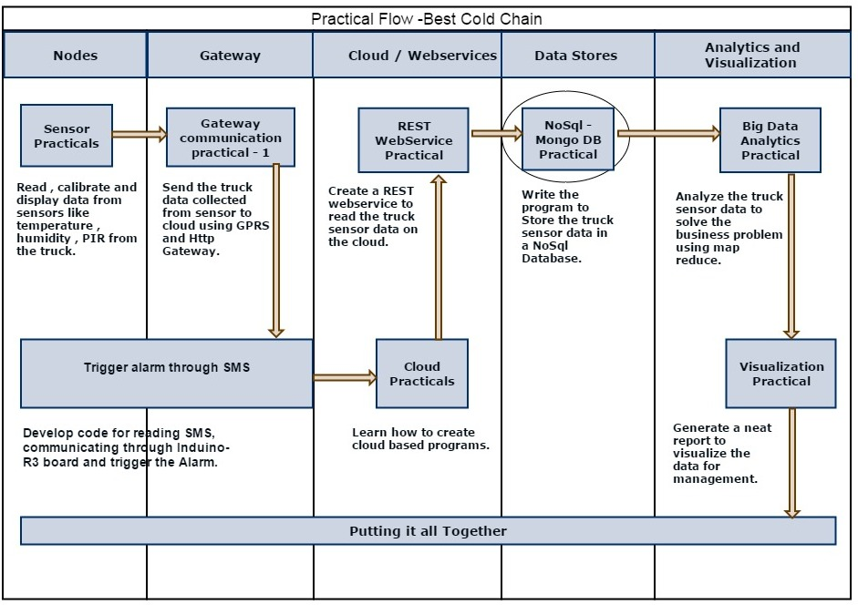
MONGODB On IOT Platform

Slide 3
MONGODB INRODUCTION:
Download MONGODB from https://www.mongodb.org/downloads
Mongo is not a relational database like Mysql
no schema so no rows or columns
It is a Document Oriented Database
Documents are stored in JSON
Any valid JSON can be easily imported and quired
Schema less; very flexible
Very fast

Slide 4
RDBMS Vs MONGODB
RDBMS | MongoDB
Database | Database
Table | collection
Row | Document

Slide 5

Starts with collection
MongoDB uses collections for storing groups of data.
A collection can be thought as a table in a relational database.
Collection
Table
Collection with Documents

Slide 6
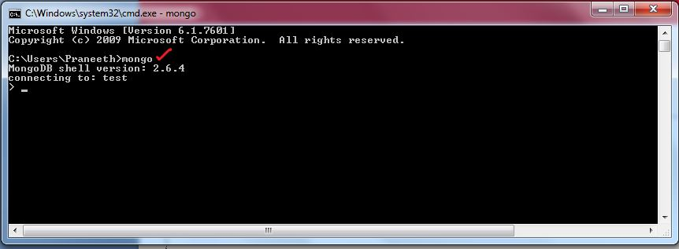
Connect to MONGODB
On command prompt use mongo command to connect the mongo server
Then start writing queries .

Slide 7
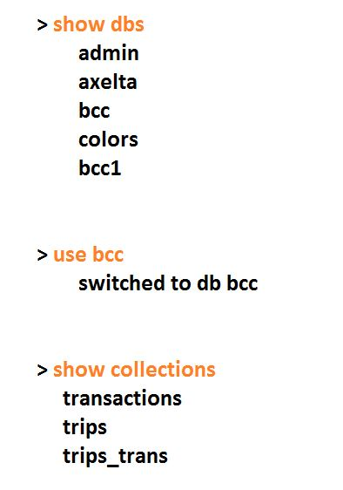
Mongo basic commands

Slide 8
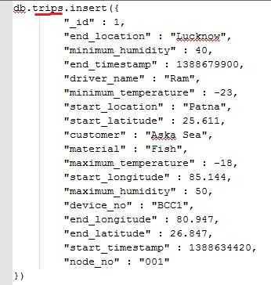
Mongo Insert

Slide 9
Select queries on RDBMS
Select * from trips where material=‘Fish’

Slide 10
Select queries on MongoDB
> db.trips.find({material:’Fish’})

Slide 11
db.trips.find()
db.trips.count()
db.transactions.find({temp: {$lte:25}})
db.transactions.find({timestamp:{$lte: 1388773800,$gte: 1388601000}})

Slide 12
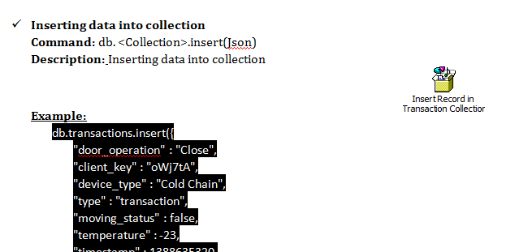
Code Snippets

Slide 13
Thank you

